Slide 1
Final Review
Automated Metal Particulate for Alcon
Mentors: Camille Lo Porciuncula, Tom Schacht, Diego Cueto, Daj Rasberry, Dr. King
Team Members: Isaac Hoyt, Matthew Luong, Yolanda Gomez, Tandol Mathew Jerthsattayanukul, Brian Ngo, Landon Stein

Slide 2
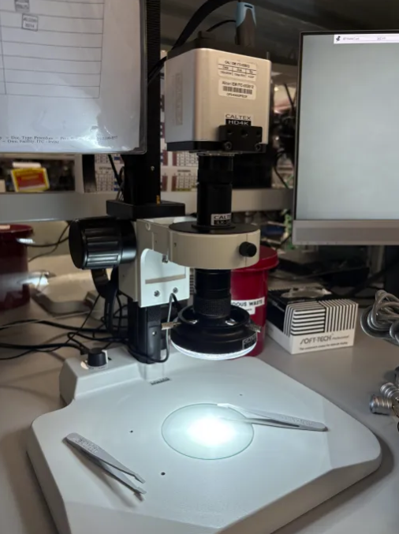
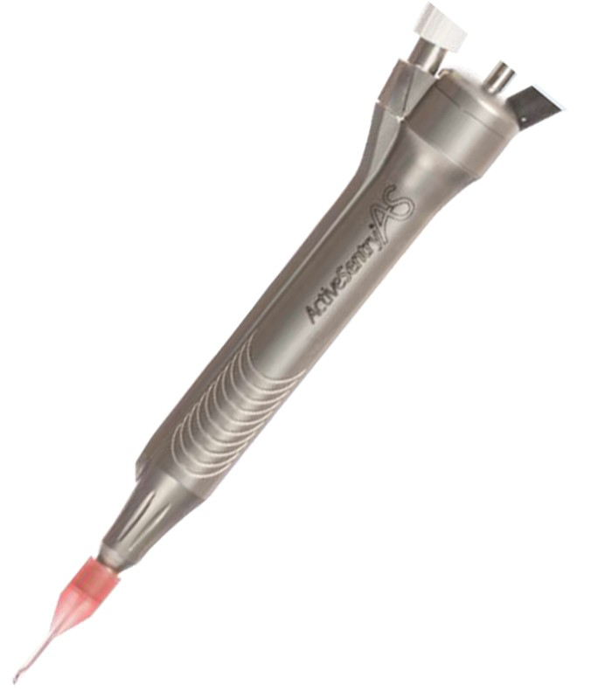
Overview
Problem
Objective
Handpieces can contain titanium particles leftover from the machining
Manual particle counting:
inefficient
can bottleneck the manufacturing process
Develop an improved process for executing the metal particulate test on Alcon’s handpiece manufacturing line
Needs to be automated, efficient, and accurate

Slide 3
Overview
System Design Requirements
Autonomous | Needs to identify and analyze metal particulate autonomously Pass/Fail
Time-Efficient | Needs to be faster than the current method Time < 20-30 minutes per quantity 10 work order
Cost-Efficient | Needs to be an affordable device for the company to reproduce Cost < $2000 (Senior Design Budget)
Identifies Particle Count | Quantifies the particulate count per given area and measures the size of each individual particle Pass/Fail
Determines Safe for Use | Needs to determine if the handpiece is ready for production given Alcon’s testing criteria Pass/Fail
Records Necessary Information | Needs the documentation of each handpiece once it has passed the test Pass/Fail
Integration of AI | Machine learning software can improve the accuracy of the script we are using to analyze particulate Pass/Fail
Useability | How accessible and easy-to-use is our prototype to technicians Pass/Fail

Slide 4
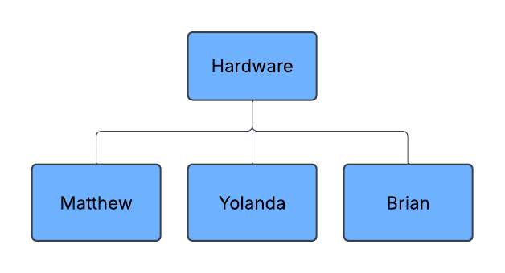
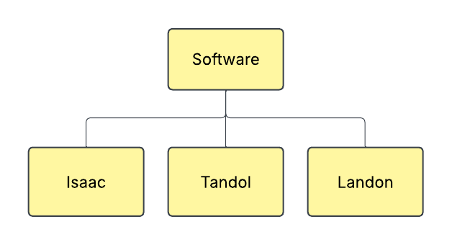
Overview

Slide 5
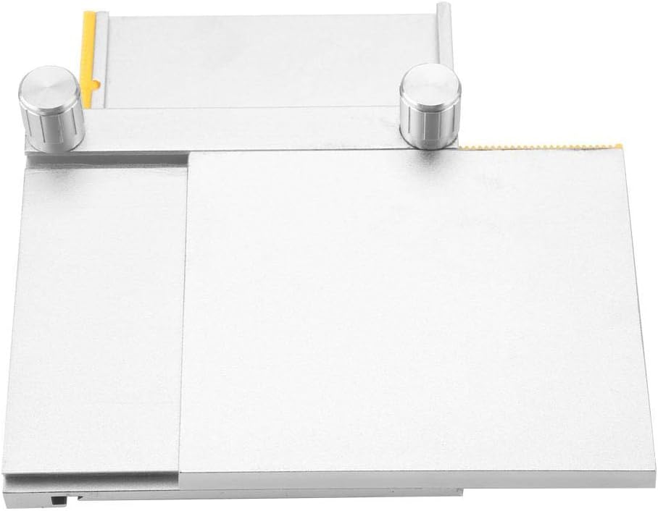
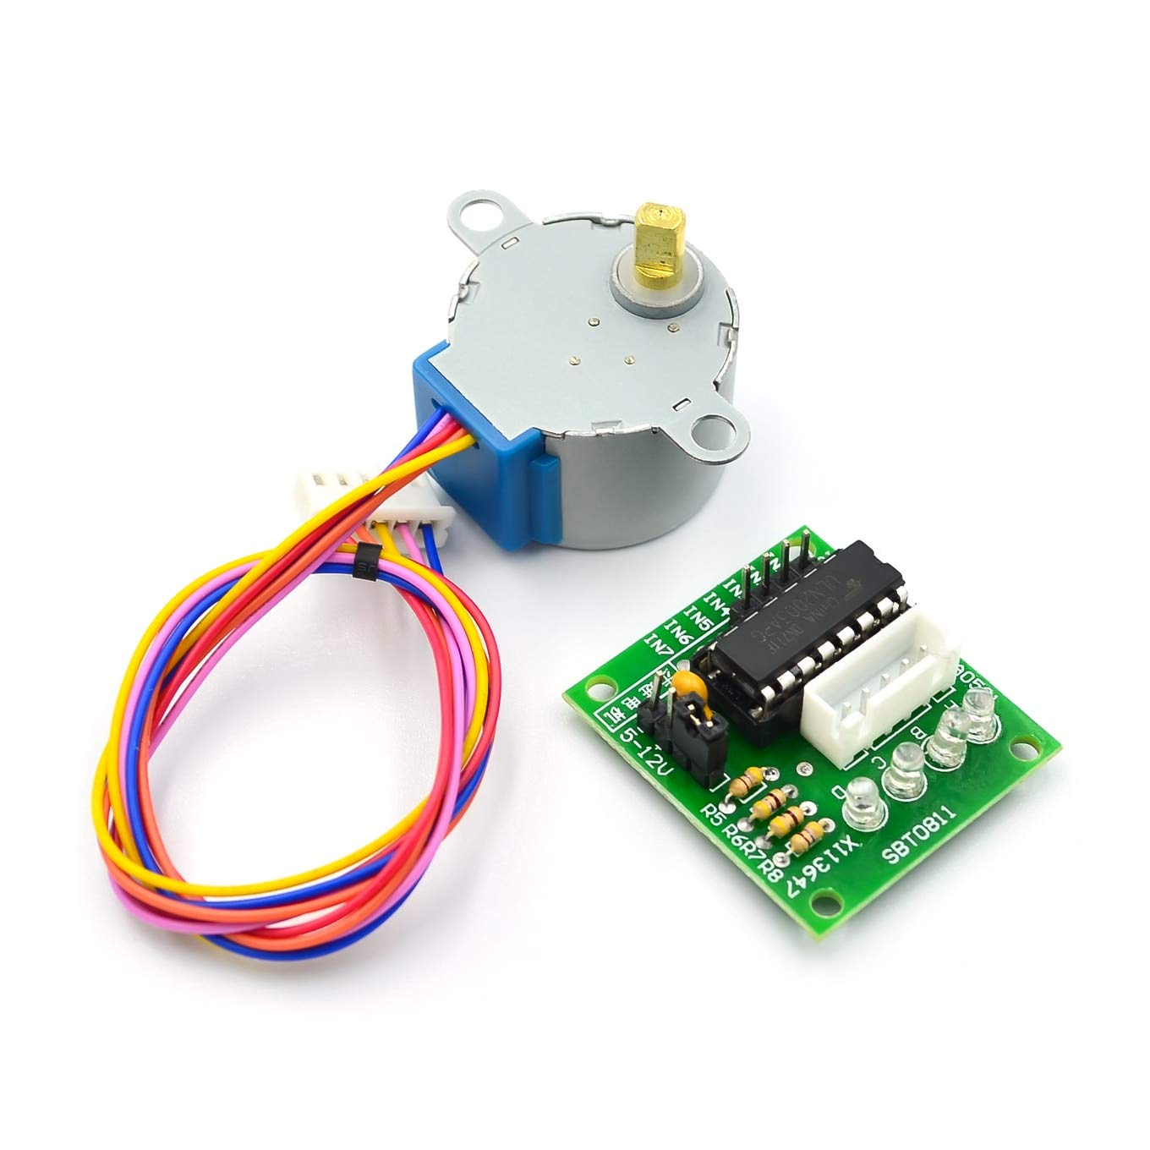
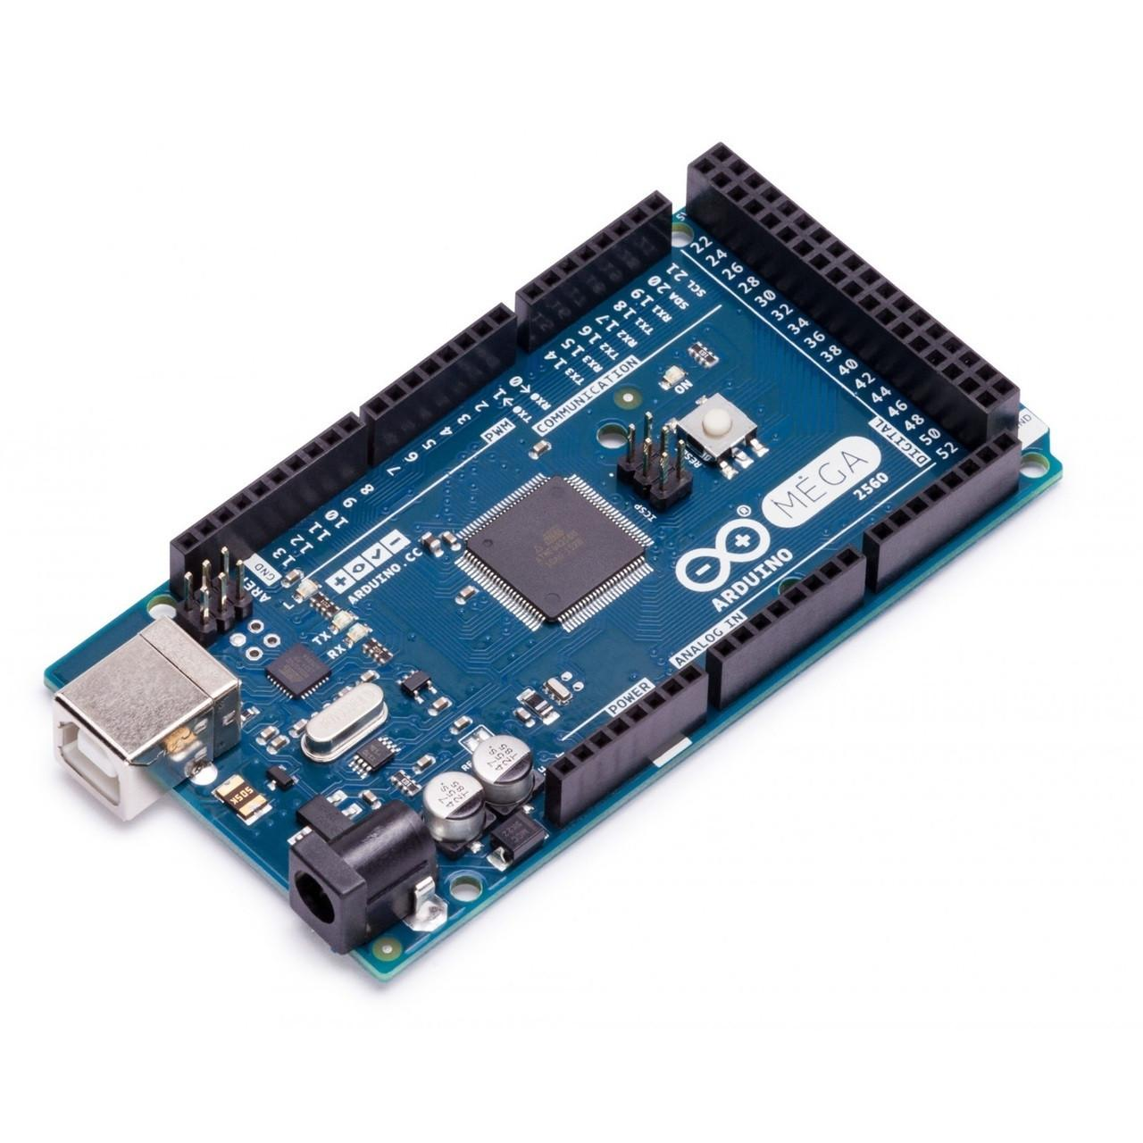
Hardware Design Criteria
Overall Mechanical Design
Precision and Accuracy | Ability to accurately pinpoint and survey the entire particulate filter
Automation Capability | Ability to reduce manual work for analyzing the particulate filter
Cost Effectiveness | Total cost of the method with 5 being the most cost effective strategy
Speed of Operation | Time it takes to analyze the particulate filter
User-Friendly Interface | How easy and accessible it is to use the method
Maintenance Requirements | How easy and efficient to maintain the system
Scale is a 1-5 scale with 5 being the most proficient and 1 being the least proficient
Hardware Components
Components | Description
X-Y Stage | Allows movement to cover the entire filter membrane
Stepper Motors | Allows movement of knobs to displace stage
Stepper Motor Modules | For precise positioning and movement control
Arduino Mega 2560 | Microcontroller for controlling stage controller movement

Slide 6
Chosen Design - Stage Controller
Part # | Name
1 | Knobs
2 | Motor Holder
3 | Stage Top
4 | Rails
5 | Bracket

Slide 7
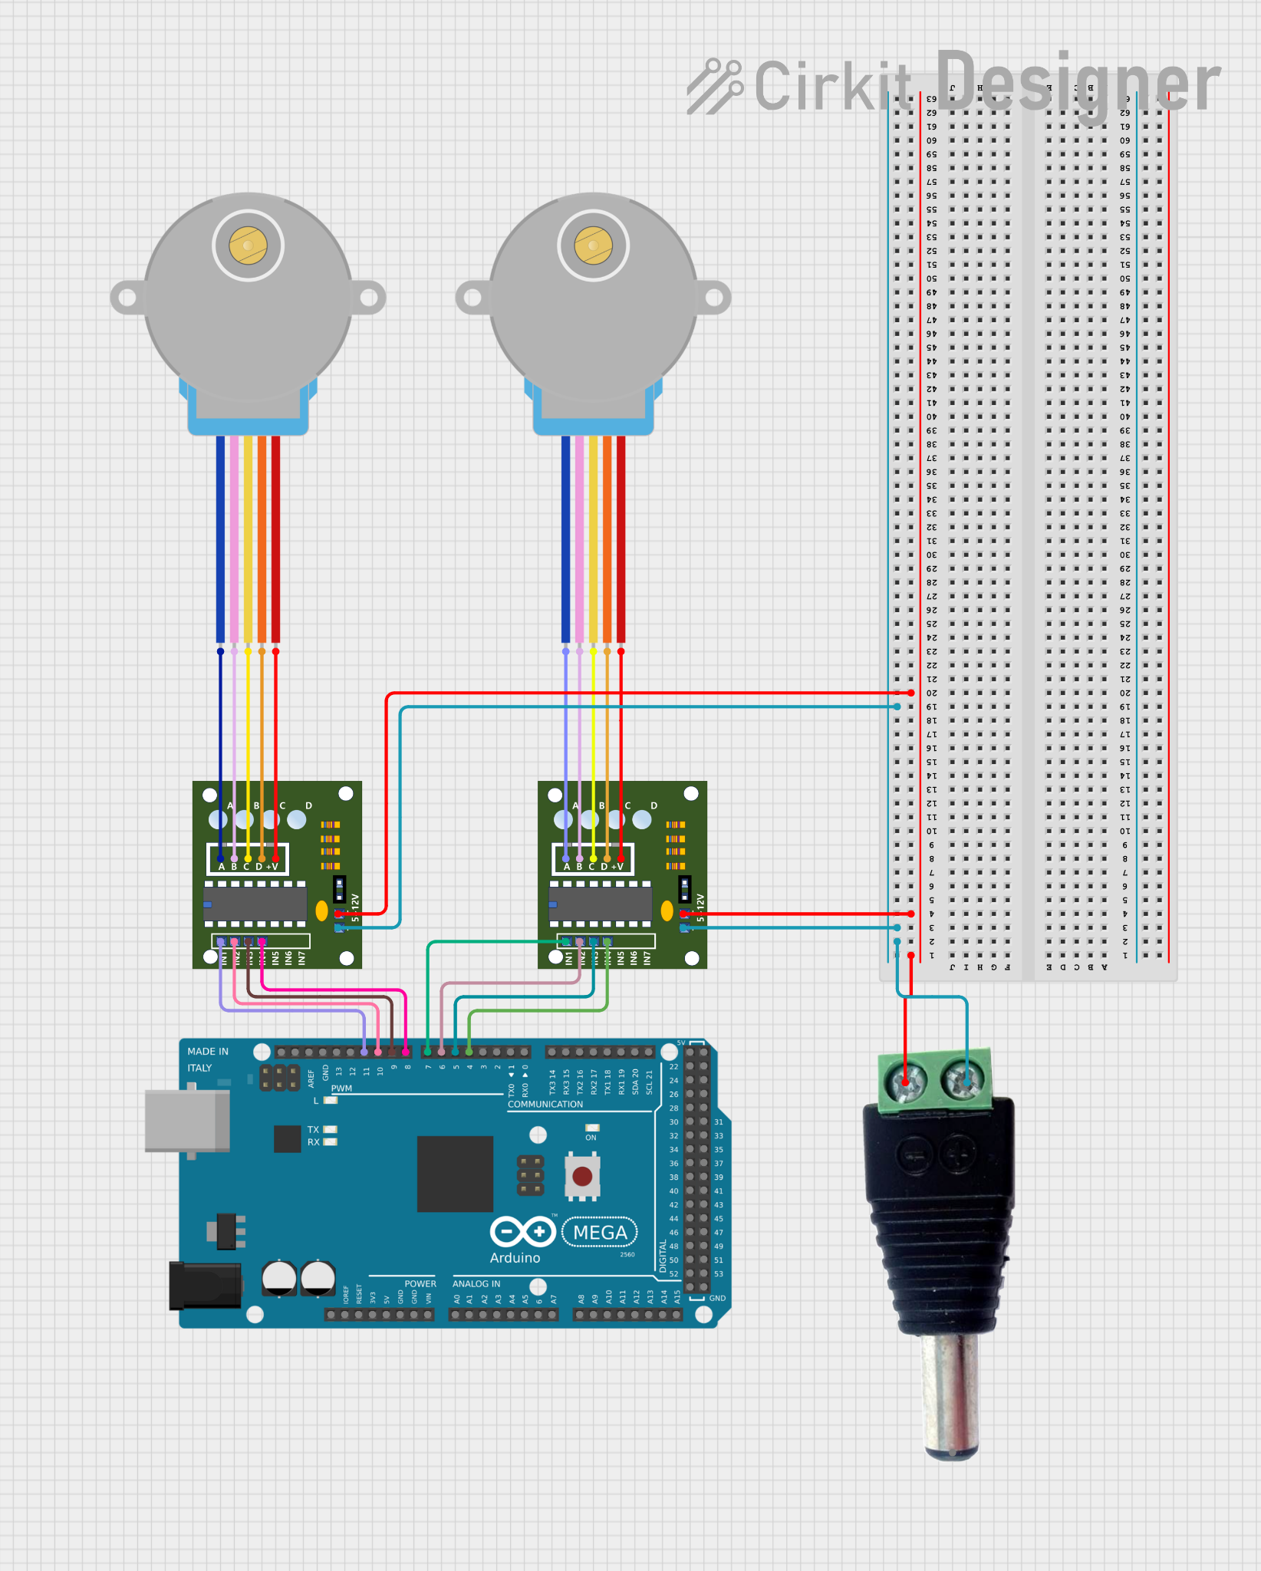
Chosen Design - Circuitry

Slide 8
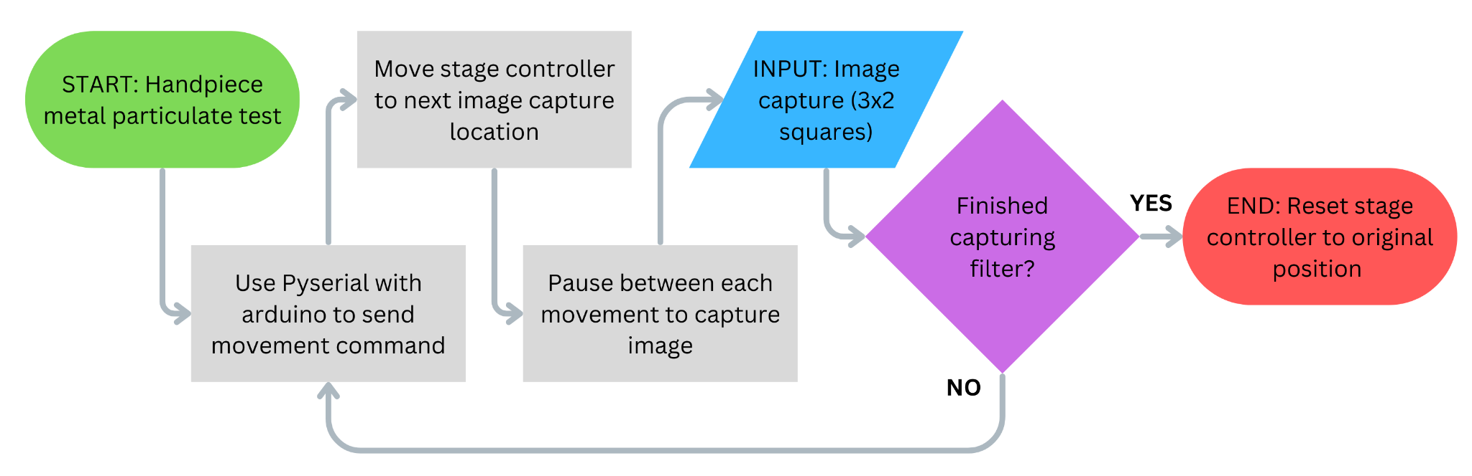
Chosen Design - Movement
Stage Controller Workflow

Slide 9
Chosen Design - Complete Set-up
Under a microscope:
Moves in a snake pattern capturing a section of the filter
Stops momentarily to take an image before moving again
Will continue until the entire area is captured

Slide 10
Chosen Design - Microscope

Slide 11
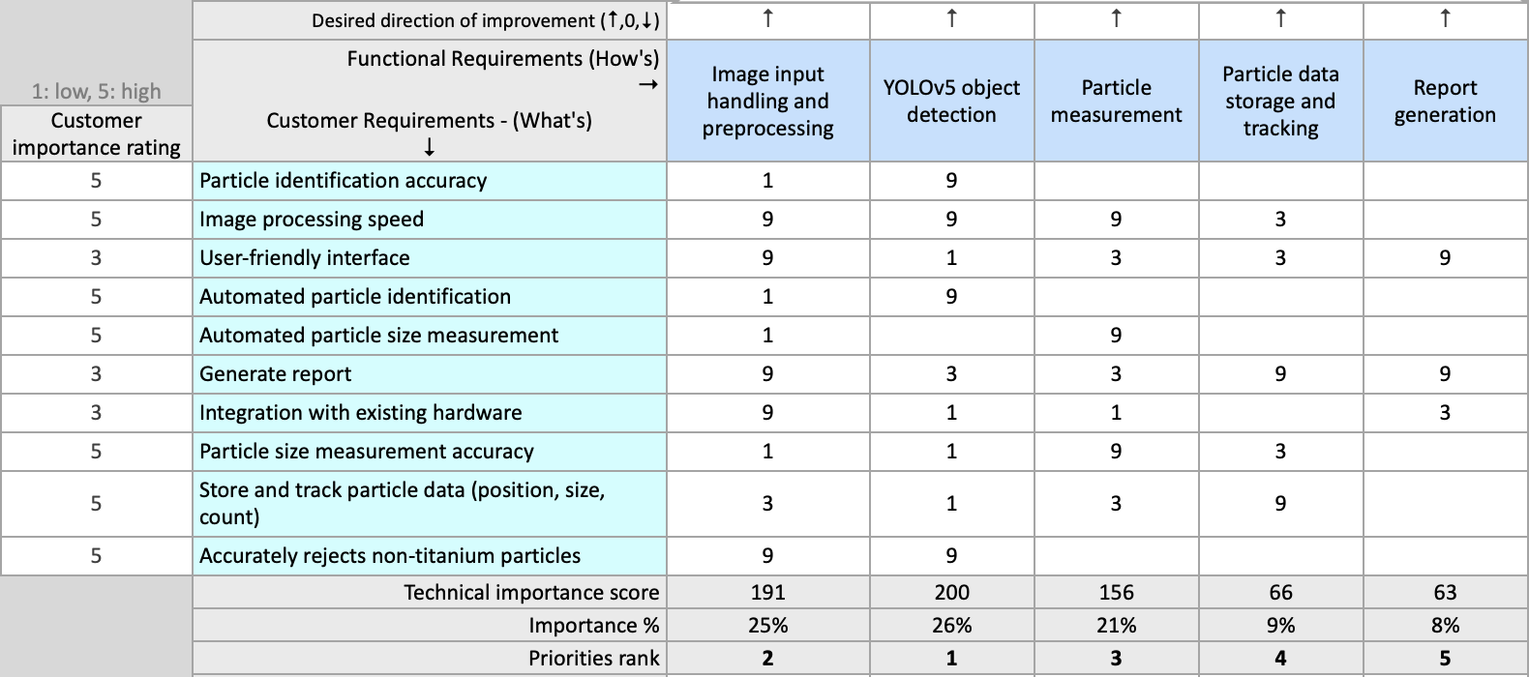
Software Requirements
House of Quality

Slide 12
Software Requirements
Overall Software Design Criteria
Particle detection automation | Minimise technician involvement
Particle detection accuracy | Must accurately reject non-titanium particles
Particle size measurement automation | Minimise technician involvement
Particle size measurement accuracy | Must be equivalent to technician measurement accuracy
Integration with existing hardware | Must be plug-and-play, should not unnecessarily increase amount of hardware needed for test
Image processing speed | Should be faster than or equal to technician
Store and track particle data | ID number, centroid location, size measurements
User-friendly interface | Generates report for technician

Slide 13

Software Requirements
YOLO (You Only Look Once)
High speed real-time image processing
Single-stage object detection
Train on two object classes:
Identify titanium particles for further measurement
Reject non-titanium particles

Slide 14
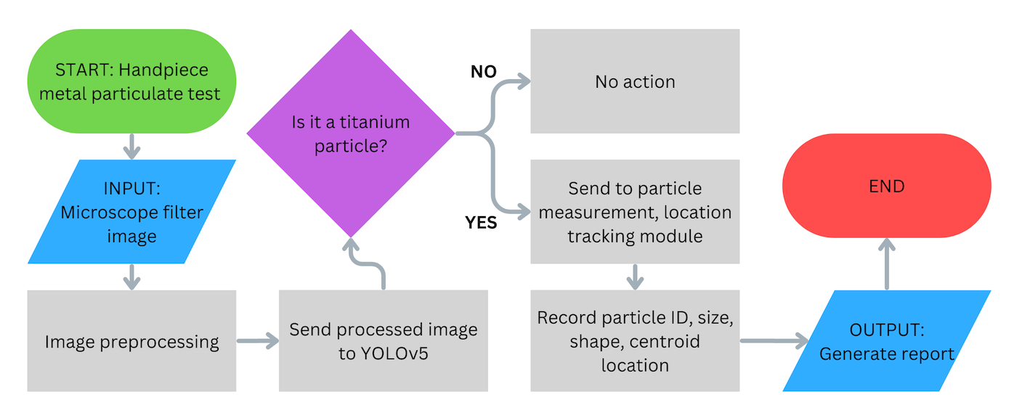
Chosen Design - Image Analysis
Image Analysis Flow Chart

Slide 15
Validation

Slide 16
Verification Tests

Slide 17
Test Procedures

Slide 18
Future Goals

Slide 19

Thank You!

